Slide 1
A Collection of Middle Corona Related Slides
Please credit as you see fit:
From: Defining the Middle Corona, Solar Physics Journal (2023)
Or, use the Defining the Middle Corona QR code:

Slide 2
Mission Summary Figures

Slide 3
✶: Structure : Flows
Skylab Heliogram
[ Spec., ✶,  ]
Skylab HAO VL Coronagraph
[ n, ✶,  ]
SMM Coronagraph/Polarimeter
[ n, pB, ✶,  ]
Mk3 & Mk4 Coronameters
[ n, pB, ✶,  ]
Historical
SOHO/EIT
[ DEM, ✶,  ]
SOHO/LASCO C1/C2
[ n, pB, ✶,  ]
SOHO/UVCS
[ Spec, ✶ ]
CORONAS-F/SPIRIT
[ Spec., ✶,  ]
Hinode/XRT
[ DEM, ✶,  ]
STEREO/EUVI
[ DEM, ✶,  ]
STEREO/Cor1
[ n, pB, ✶,  ]
STEREO/Cor2
[ n, pB, ✶,  ]
Observatory off ☉-♁ Line
CORONAS-PHOTON/TESIS
[ Spec., ✶,  ]
GOES/SUVI & PROBA2/SWAP
[ DEM, ✶,  ]
SUVI & SWAP Offpoints
[ ✶,  ]
SDO/AIA
[ DEM, ✶,  ]
Infrequent Offpoints
[ DEM, ✶,  ]
CoMP
[ $\overset{⃗}{B},$pB, v, n, ✶,  ]
KCor
[ n, pB, ✶,  ]
Present
SolO/EUI
[ DEM, ✶,  ∠33° ]
EUI Extended FOV
[ ✶,  ∠33° ]
SolO/METIS
[ n, pB, ✶, , ∠33° ]
6R☉
5R☉
4R☉
3R☉
2R☉
1R☉
Peak CME Acceleration
Flare Reconnection
Open-Closed Transition
Solar Wind Acceleration
Solar Disk
Inner Corona
Middle Corona
Outer

Slide 4
PROBA3/ASPIICS
[ n, pB, ✶,  ]
✶: Structure : Flows
UCoMP
[ $\overset{⃗}{B},$pB, v, n, ✶,  ]
PUNCH/NFI
[ n, pB, ✶,  ]
Aditya-L1/VELC
[ n, pB, ✶,  ]
NOAA/CCOR
[ n, ✶,  ]
Near Term
CubIXSS CubeSat
[ Abundances, DEM ]
SunCET CubeSat
[ ✶,  ]
COSMO/Large Cor.
Offset
[DEM, pB, ✶,  ]
Vigil/EUV
[ ✶, , @ L5 ]
Vigil/COR
[ n, pB, ✶, , @ L5 ]
Proposed
ECCCO Imager and Spectrometer
[ ✶, , Spec, DEM ]
6R☉
5R☉
4R☉
3R☉
2R☉
1R☉
Peak CME Acceleration
Flare Reconnection
Open-Closed Transition
Solar Wind Acceleration
Solar Disk
Inner Corona
Middle Corona
Outer
Radio: Direct Observation & Interplanetary Scintillation Diagnostics
[ v, $\overset{⃗}{B}$, Plasma & particle dynamics]
GHz Range | Bremsstrahlung
MHz Range | Plasma Emission
Instrument | Freq. Range (MHz) | Resolution | Status
JVLA P Band (USA) | 230–470 | ~1´ @ 350 MHz | In Operation
Nancay (France) | 150–450 | ~2´ @ 150 MHz | Newly Upgraded
MWA (Australia) | 80–240 | ~5´ @ 150 MHz | In Operation
GRAPH (India) | 40–150 | ~5–8´ @ 150 MHz | In Operation
LOFAR LBA (Netherlands) | 30–80 | ~9´ (Tied Array) ~1´ (Interferometry) | In Operation
Present
Radio Observatories
Near Term
Radio
Instrument | Freq. Range (MHz) | Resolution | Status
OVRO-LWA (USA) | 20–88 | ~5´ @ 80 MHz | Commissioning
SunRISE (Space) | 0.1–1.5 | Varies | Phase C

Slide 5
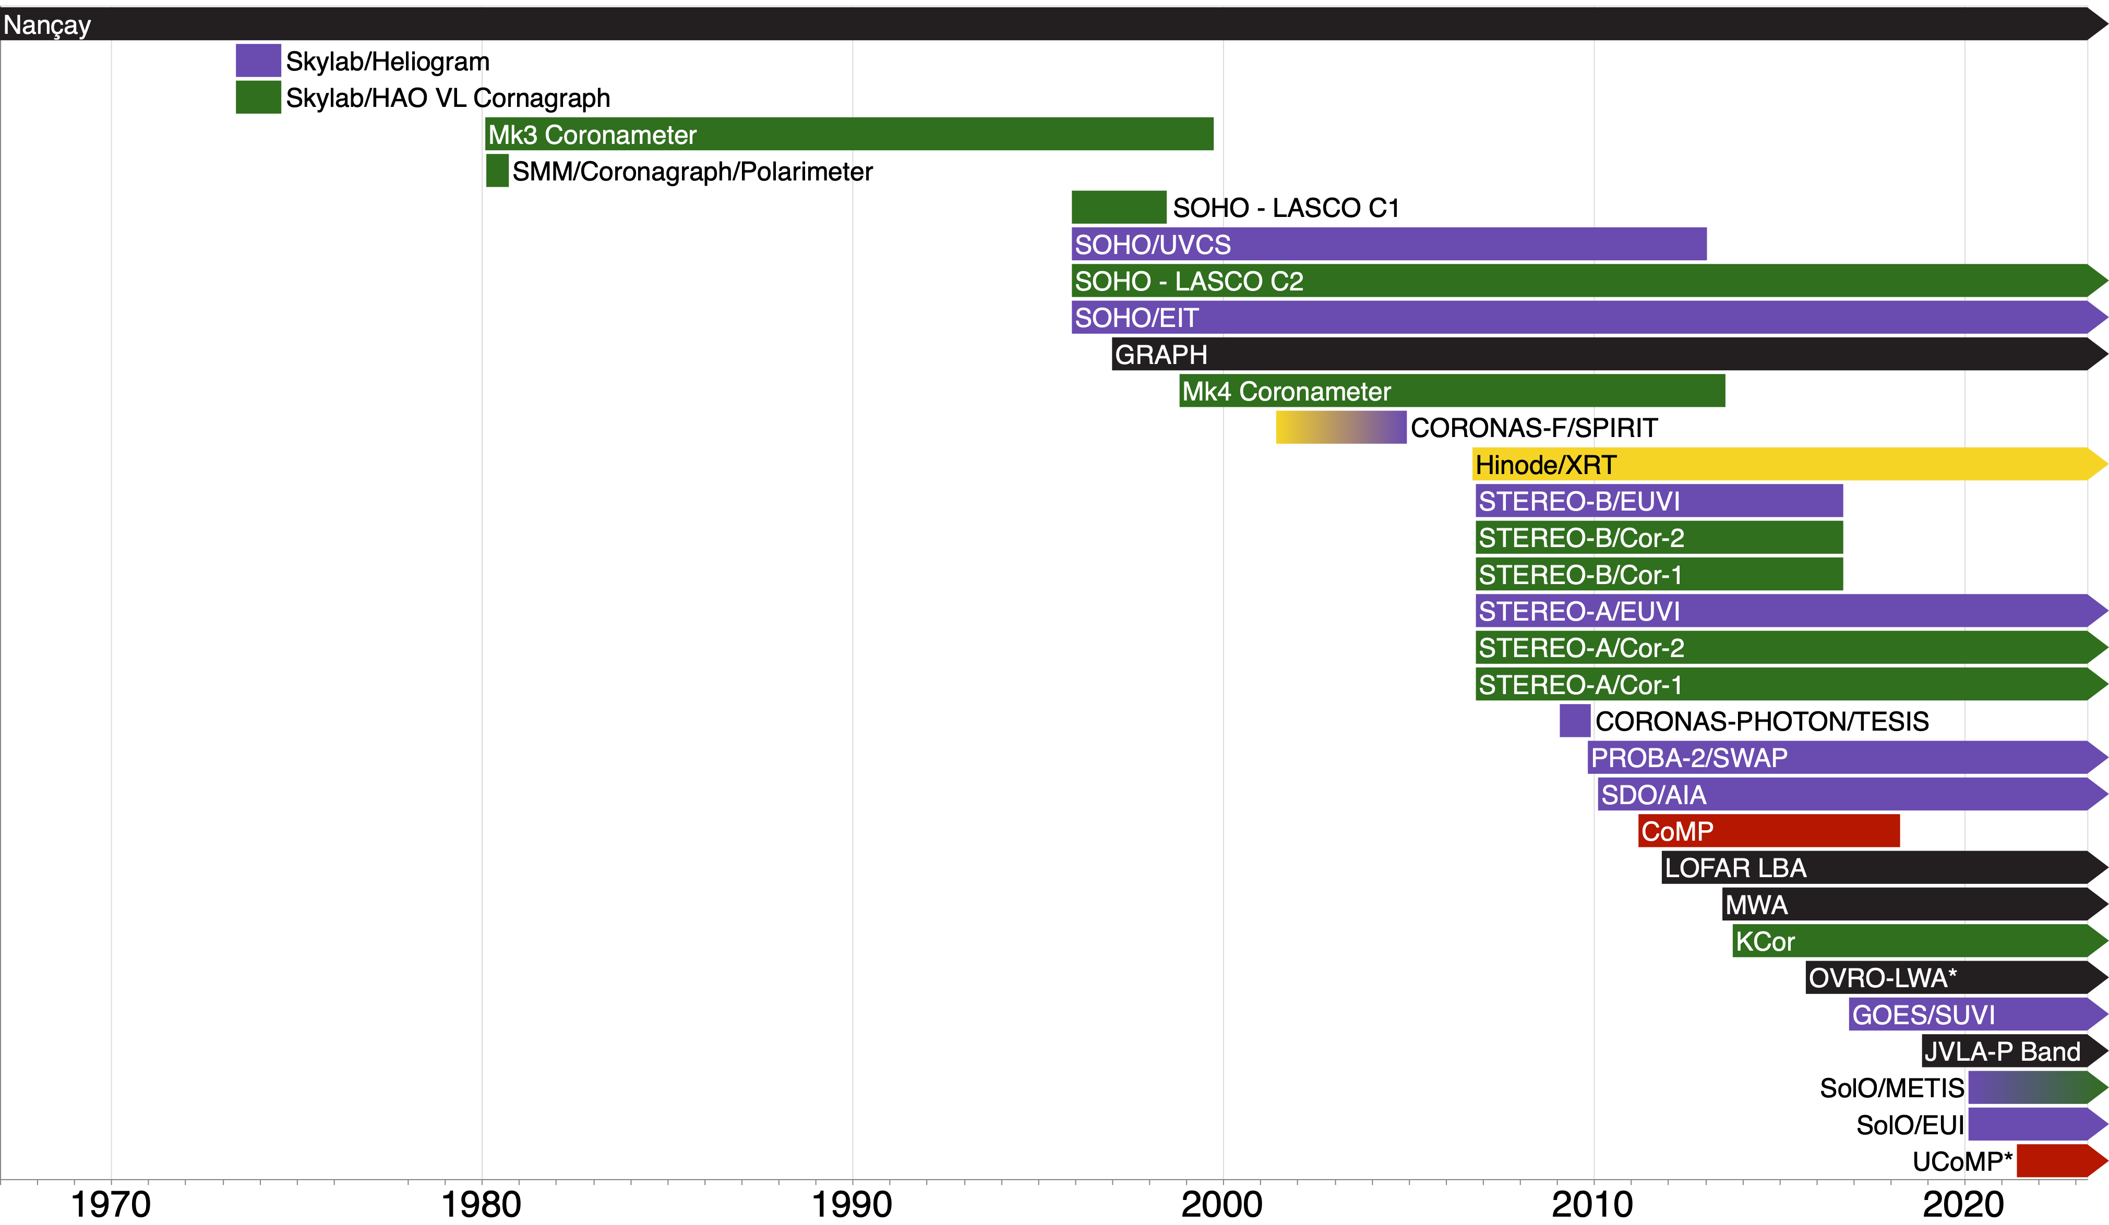

Slide 6
The Middle Corona Overview

Slide 7
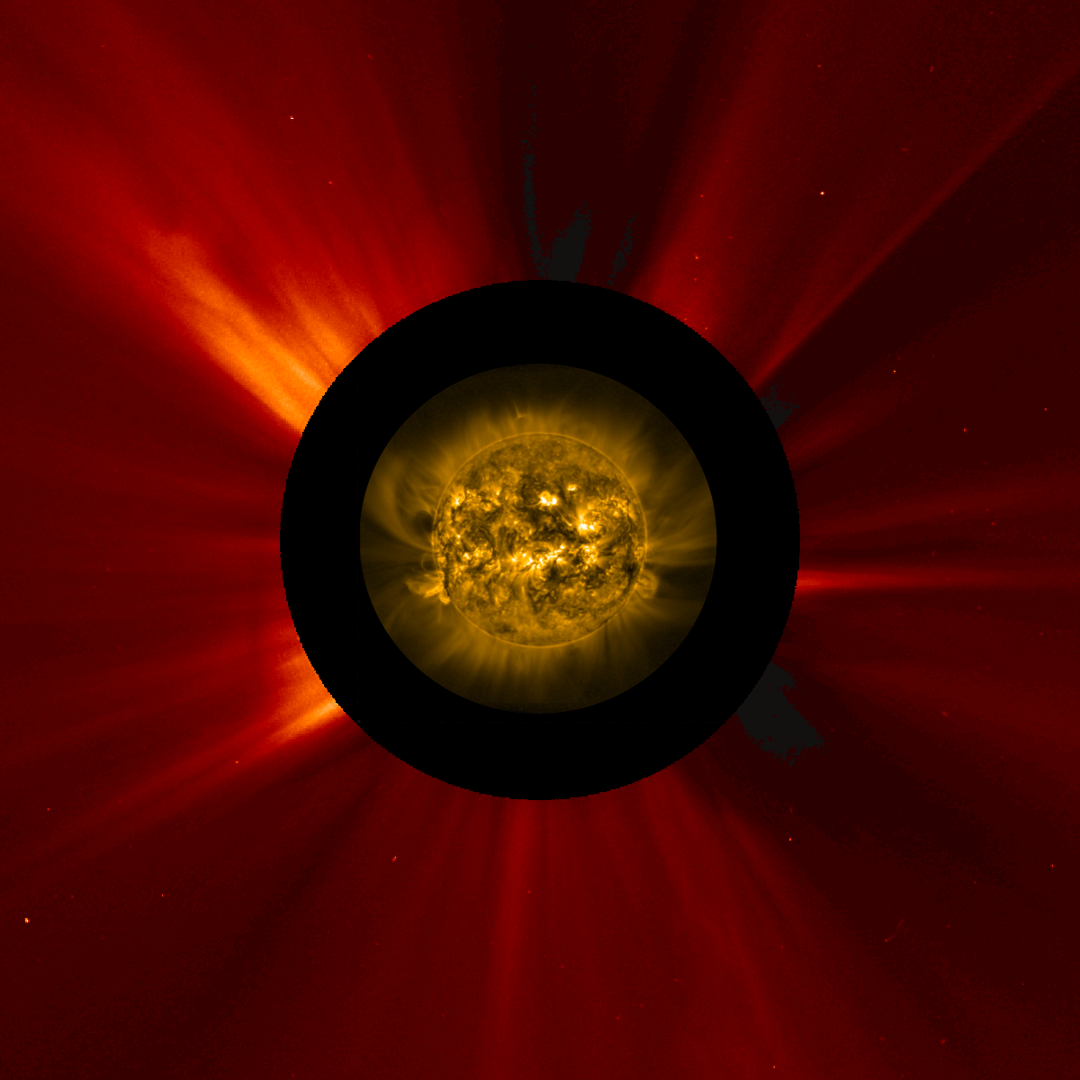

Slide 8
Physical Transitions in the Middle Corona
White Light Observations
$$β≪1$$
EUV / X-ray Observations
Observational gap
$$β<1$$
$$β>1$$
Peak CME Acceleration
Flare Reconnection
Open-Closed
Field Transition
125 (10) km/s
Regions
T (K)
n (kg m⁻³)
200 (30) km/s
Photosphere
~1.0×10⁴
8.0×10⁻⁵
Chromosphere
~1.0×10⁵
~1.0×10⁻¹¹
Transition Region
~1.0×10⁶
~5.0×10⁻¹³
Fast (Slow) Solar Wind Speed
275 (80) km/s
Inner Corona
>1.0×10⁶
<5.0×10⁻¹³
Middle Corona
1.5–6 R⦿
350 (120) km/s
To Heliosphere
400 (160) km/s

Slide 9
Open-Closed
Field Transition
125 (10) km/s
200 (30) km/s
Observational Gap
3 R☉
275 (80) km/s
2 R☉
350 (120) km/s
1 R☉
Middle Corona (1.5–3 R☉)
400 (160) km/s
Peak CME Acceleration
Flare Reconnection
125 (10) km/s
200 (30) km/s
275 (80) km/s
Flare Loops
Fast (Slow) Solar Wind Speed

Slide 10
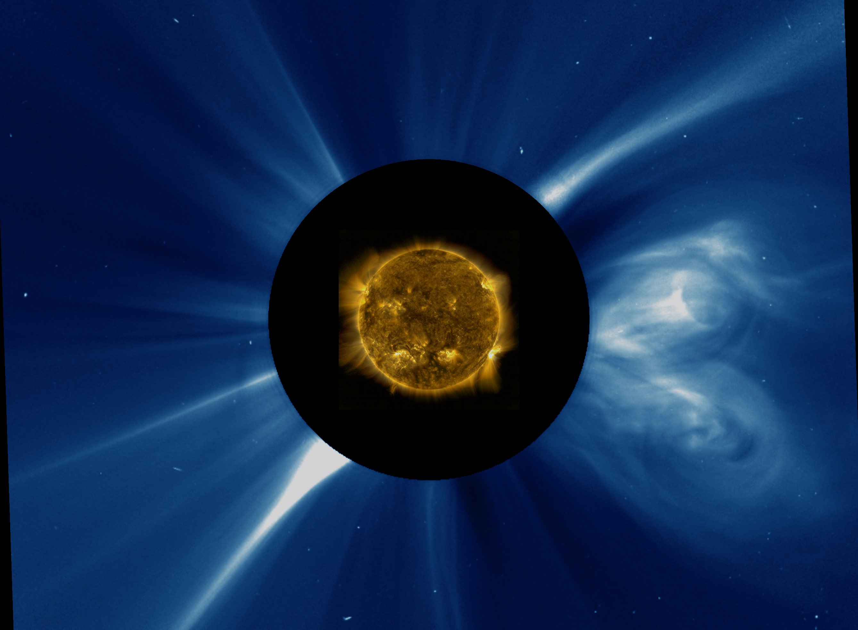
125 (10) km/s
Observational Gap
200 (30) km/s
3 R☉
275 (80) km/s
Middle Corona (1.5–3 R☉)
2 R☉
350 (120) km/s
1 R☉
400 (160) km/s
Solar Wind Outflow
Peak CME Acceleration
Open-Closed
Field Transition
Flare Loops
Flare Reconnection

Slide 11
The Middle Corona Overview

Slide 12
Defining The Middle Corona

